Slide 1
IS 120
Git and GitHub

Slide 2
Announcements
HW 3 is up
  Almost all assignments from now on we will use GitHub
Class survey
Slack

Slide 3
What is Git?
A version control system
  See history
  Undo mistakes
  Collaborate safely
  Branch and experiment
It is very popular and widely used

Slide 4
What is GitHub?
A Git platform
  Hosts your repository
  Use Git features to see history and manage versions
  Easy static website hosting with GitHub Pages
  Lots of other cool features like GitHub Actions

Slide 5




Git Platforms

Slide 6
What is a repository?
A container for your project
Includes all versions (branches) of your project
Often referred to as a repo
Let’s go make one

Slide 7
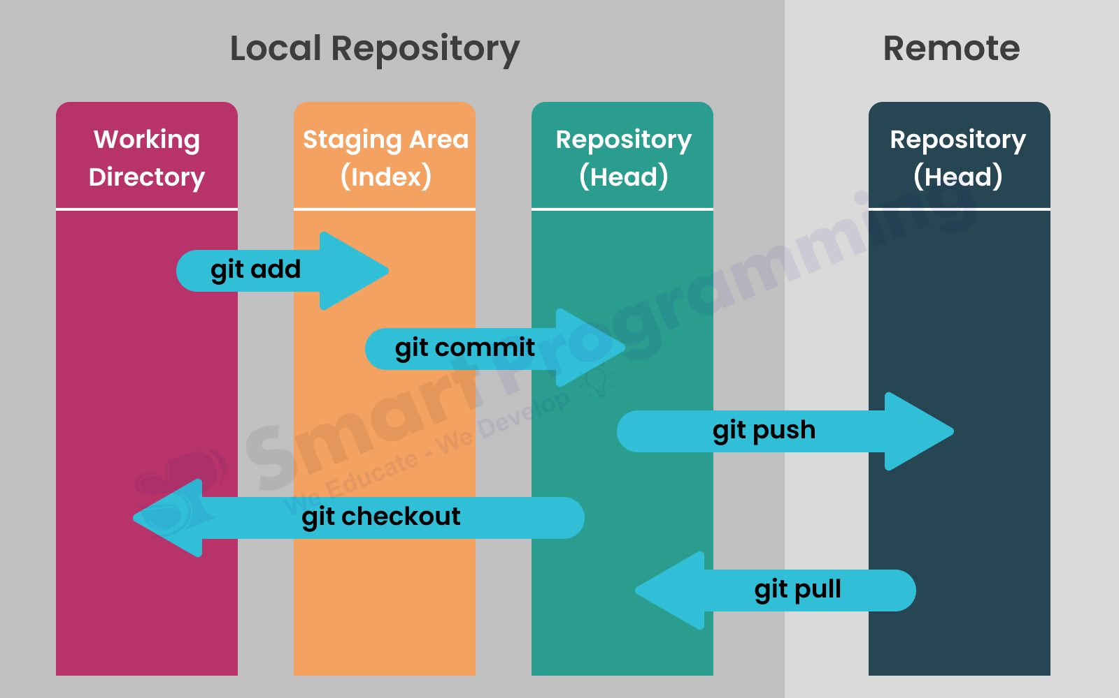

Slide 8
Git Branches
How different versions of your project are stored
View different branches using git checkout
Traditional branches
  main (master)
  dev
  feature/name
  bug/name

Slide 9
Git Pull Request (PR)
A request to implement changes from one branch to another
“Pull” sounds a little backwards, think of someone pulling your changes into their branch
PRs usually have automated tests and a manual approval process
This is a term you will hear a lot in industry

